Slide 1

Predictive Modeling for Attorney Involvement in Claims
By Group 4
Shaik Mohammad Waseem Akram
Gowthami N
Saumya Srivastava
Prerana V Kolambkar
Nagesh hp
Aswal M K
Punati Pardh Akash

Slide 2

PROBLEM STATEMENT
The goal of this project is to develop a predictive model that determines the likelihood of attorney involvement in insurance claims. By leveraging historical claims data, the model will help insurance companies proactively identify cases that are likely to involve legal representation, enabling them to optimize claim handling strategies, reduce litigation costs, and enhance customer satisfaction.

Slide 3

DATASET DETAILS
COLUMN NAME | DESCRIPTION
CASENUM | Unique identifier for each claim.
ATTORNEY | Target variable: 1 if an attorney was involved, 0 otherwise
CLMSEX | Claimant's gender (possibly encoded as 1 = Male, 2 = Female, or NaN for missing values).
CLMINSUR | Whether the claimant was insured at the time of the accident (1 = Yes, 0 = No).
SEATBELT | Whether the claimant was wearing a seatbelt during the accident (1 = Yes, 0 = No).
CLMAGE | Age of the claimant at the time of the claim.
The dataset for this project should contain historical insurance claim records with features that influence attorney involvement. Below are the key components of the dataset

Slide 4
COLUMN NAME | DESCRIPTION
LOSS | Estimated loss amount associated with the claim.
ACCIDENT_SEVERITY | Categorical variable indicating accident severity (e.g., Minor, Major, Fatal).
CLAIM_AMOUNT_REQUESTED | The amount of money requested by the claimant.
CLAIM_APPROVAL_STATUS | Claim status (e.g., 1 = Approved, 0 = Denied).
SETTLEMENT_AMOUNT | The amount the insurance company agreed to settle for.
POLICY_TYPE | Type of insurance policy (e.g., Comprehensive, Third-Party).
DRIVING_RECORD | Claimant's driving history (e.g., Clean, Minor Violations, Major Violations).

Slide 5

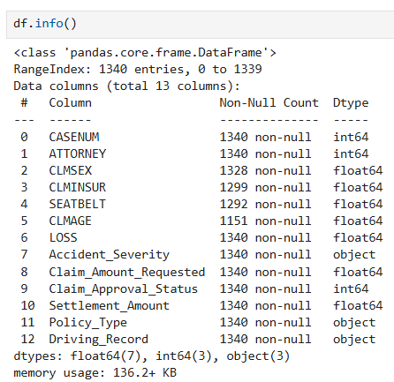
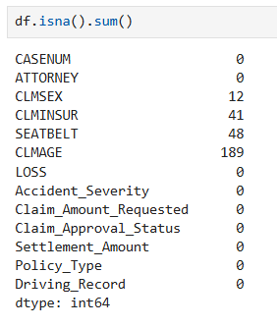
EXPLORATORY DATA ANALYSIS
DATA CLEANING:
checking for the null values
examining the data types
changing the data types of required columns
resulting null values are dropped using dropna().
dropping unnecessary columns (Unnamed: 0)

Slide 6
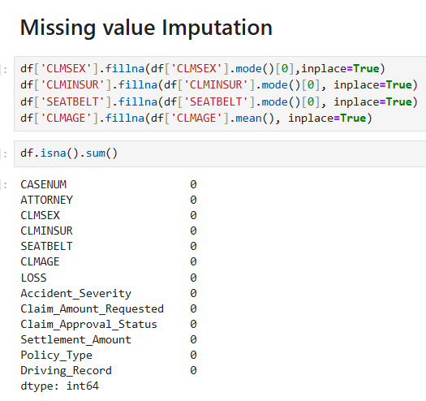
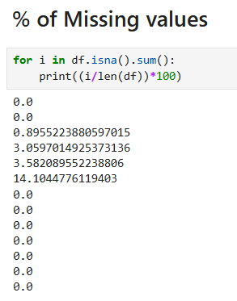

Slide 7
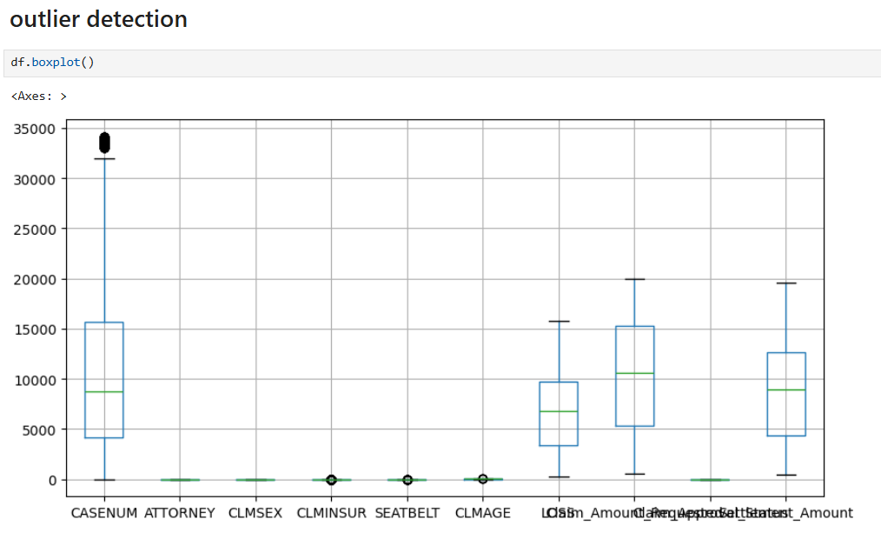


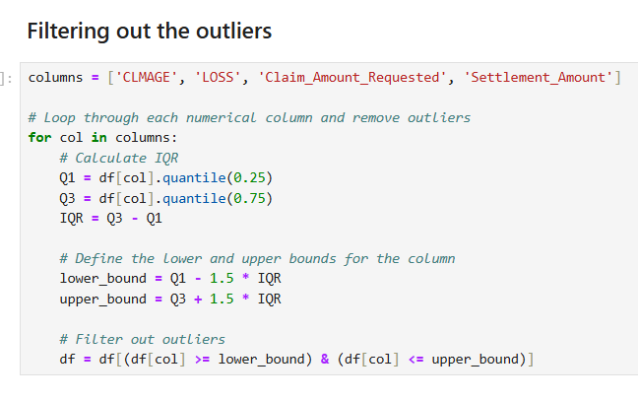
OUTLIER DETECTION
After Removing outliers
Before

Slide 8

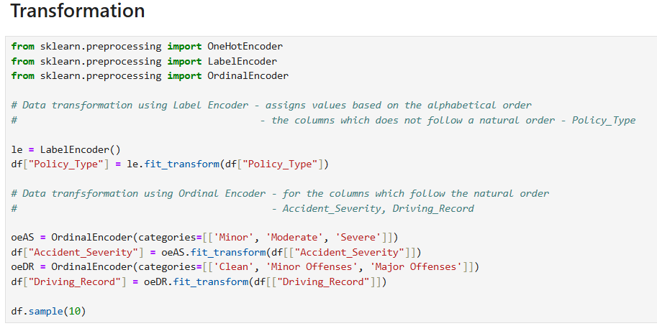
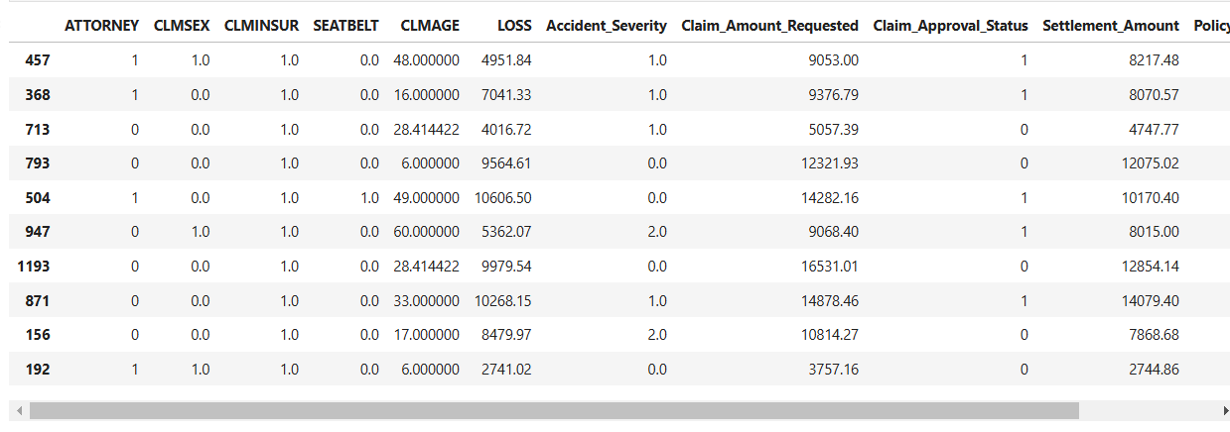
TRANSFORMATION

Slide 9
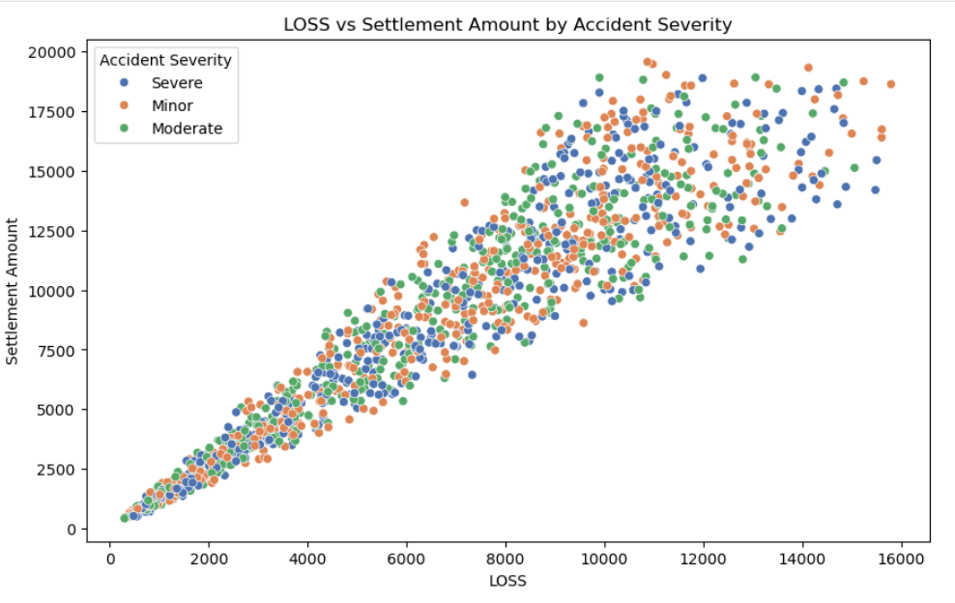
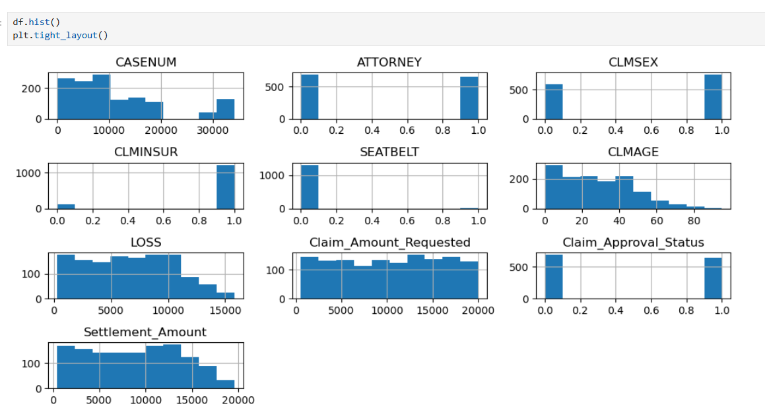
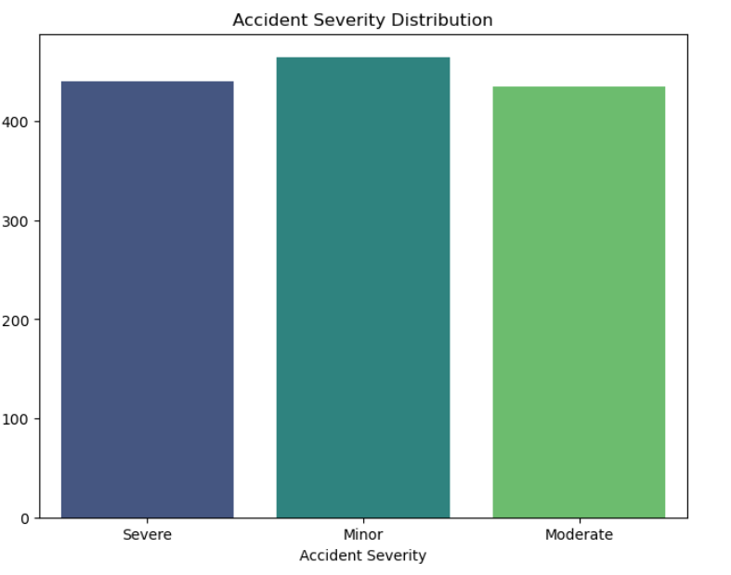
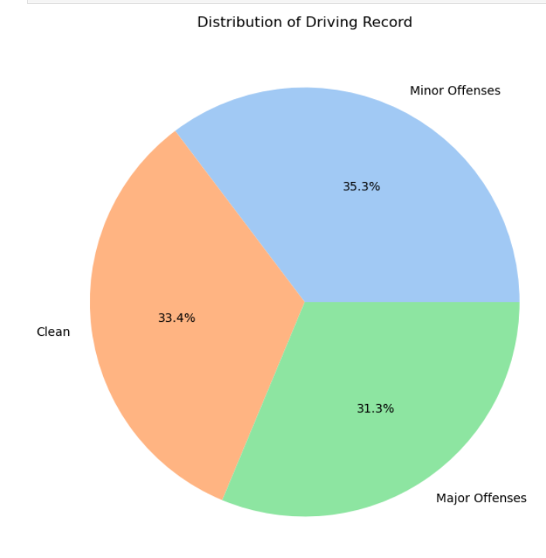
DATA VISUALIZATION
DATA VISUALIZATION- used boxplot, countplot, barplot, KDE plot, pie chart, scatter plot to further deepen our understanding of the dataset.

Slide 10
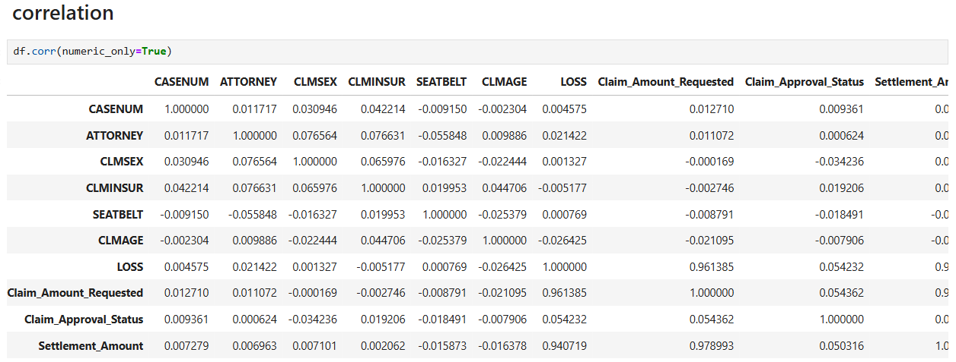
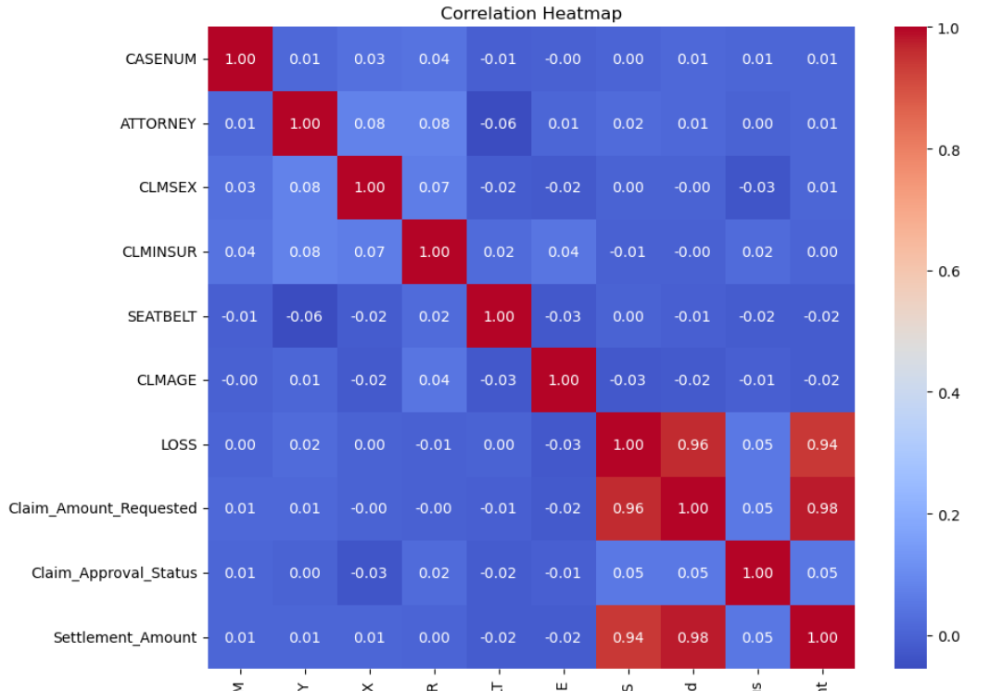
The correlation values and predictive power scores of the dataset are thoroughly examined.

Slide 11
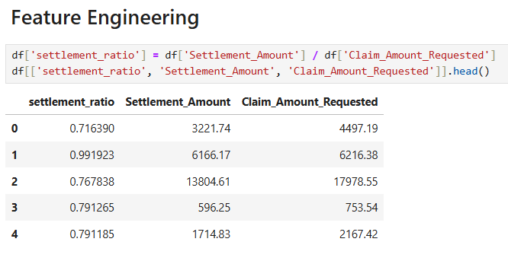
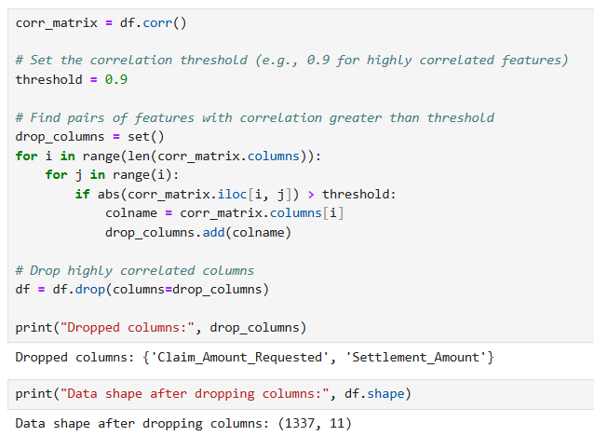
FEATURE ENGINEERING

Slide 12
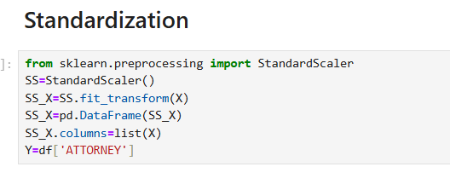
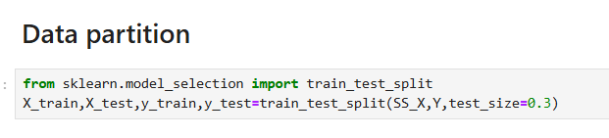

Slide 13
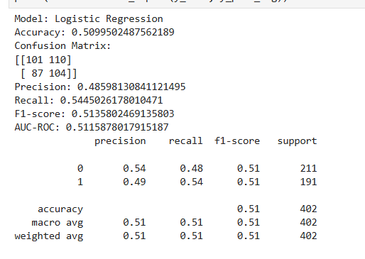
MODEL BUILDING
We used various machine learning models to build the classification model that predicted if a customer would churn or not. The models used are:
Logistic Regression
SVM
Naive Bayes
KNN
Random Forests
Logistic Regression

Slide 14
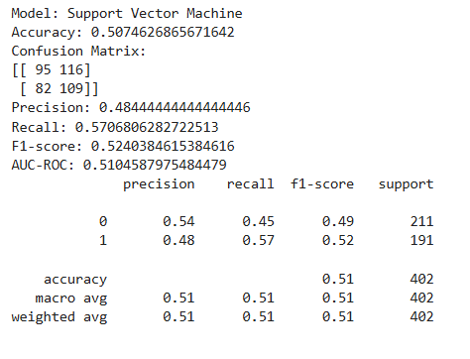
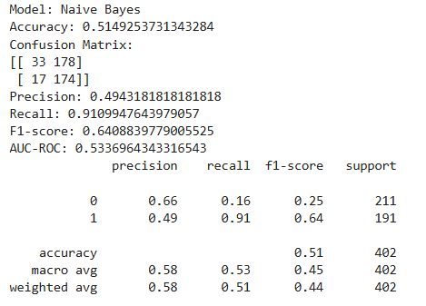
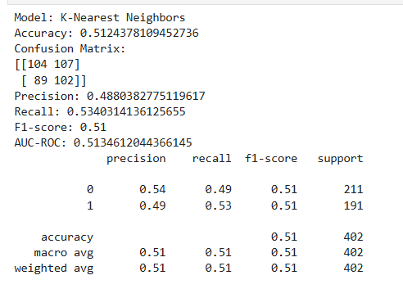
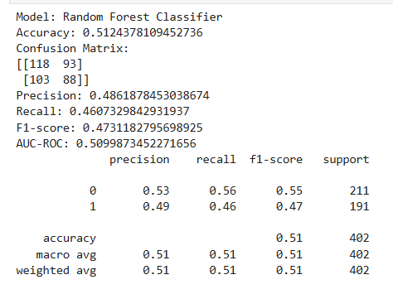
Support Vector Machine
Naïve Bayes
K- Nearest Neighbors
Random Forest Classifier

Slide 15
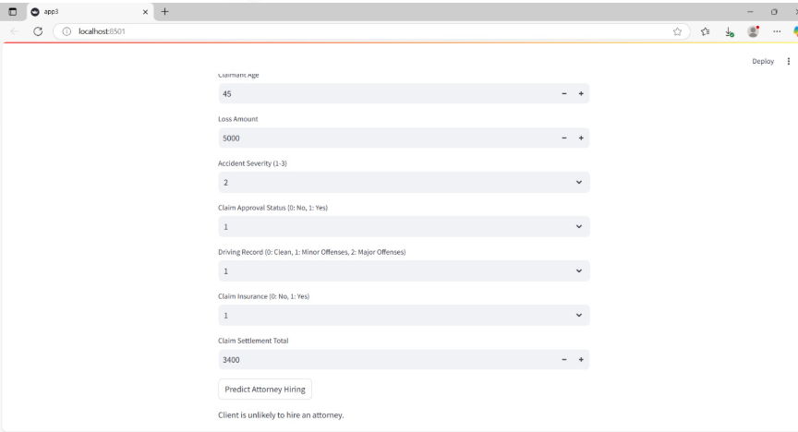
DEPLOYMENT
We used Streamlit, a Python-based web framework, to build an interactive web application for predictions.
The model is deployed as a real-time web app, allowing users to input claim details and receive instant predictions.

Slide 16
Thank you

